Slide 1


PSYC7142 Understanding Humans Through Data

Slide 2
PSYC7142: Weeks 1 - 5
My name is Dr. Samuel Finnerty. I am an expert in social and environmental psychology, public understanding of science, and mixed-methods research.
Ask me anything:
Questions during practical labs
All other questions on discussion forum on Moodle
Notes:
Note that the other videos will be provided by Prof. Padraic Monaghan…..

Slide 3
Module aims
Be able to utilise the popular and powerful R statistical application for your own research
Learn to identify the data analysis approach that can be applied to test theoretical beliefs against evidence
Recognise and apply appropriate statistical tests to different data
Describe the findings from analysing data effectively in text
Write a journal-style short report of a data analysis
Relate data analysis findings to scientific insights, linked to psychological theory
Notes:
Once complete - Running throughout is that we are looking at psychological behaviour, here is some data about it, but really what we are interested in is the behaviour, uncovering that, and explaining that.

Slide 4
Assessment
Assessment will be 100% by coursework
A series of short assignments every three weeks (due Friday of weeks 3, 6, and 9, contributing 0/20%/20% of the grade)
  The assignments are designed to make sure you develop the key skills of data preparation and analysis as the course progresses.
  The first assignment does not count towards your final mark, it is used to assess progress.
A short research report (1500 words, due after Christmas break, contributing 60% of the grade).
  Analyse and report the findings from a previous experimental study in the format of the results section from an article in a leading short-format high impact journal (e.g., Psychological Science).
  Concise, effective reporting of analytic methods, findings and interpretation according to the best professional standards.

Slide 5
Structure and set-up of the course
Ten weeks of material
Within each week there are two activities:
  Recorded lectures
    Background to the theory, discussion of the tests, introduction to the practical
  Practical class
    Materials to work through in conducting your own data analyses
    Foundations, consolidation, extension

Slide 6
Structure and set-up of the course: how it works
Here is how it works
  Step 1. Watch the lecture(s)
  Step 2. Get together in your practical group to go through the practical workbook.
  Step 3. Attend the practical class as a group to go through the workbook
    Tutors will be available to respond to the questions/queries
  Step 4. In weeks 3, 6, 9 complete the assignment and submit by Friday 8pm

Slide 7
Objectives for Week 1
By the end of Week 1, you should be able to:
Understand the importance of data analysis and statistics
Identify types of data in psychology (nominal, ordinal, interval, ratio)
Understand means and standard deviations
Understand standardized scores (Z-scores)
Use R-studio to begin to manipulate data, investigate means and standard deviations, and convert scores into Z-scores
Notes:
Types of data - Because exactly what we are measuring determines how we are going to analyse that data.

Slide 8
What is the point?
Do rose tinted glasses help with reading?
The task: children read a list of words as quickly as possible, with rose-tinted glasses and with clear-lens glasses
Wow! A 50% increase! They really work!!
  Or do they?
What more do you need to know about this study to be able to determine whether rose-tinted glasses help reading?
Clear-lense Glasses | Rose-tinted Glasses
50 words per minute | 75 words per minute
Ritchie, S. J., Della Sala, S., & McIntosh, R. D. (2011). Irlen colored overlays do not alleviate reading difficulties. Pediatrics, 128(4), e932-e938.
Available here: https://pdfs.semanticscholar.org/06ed/f49b323e86cc115ca05d882d44afef6b4848.pdf
Notes:
So there is an idea that tinted glasses, in particular rose-tinted glasses, help with reading. We need to think critically about this, as data scientists, as psychologists.
Pause the video here and think about what you would need to do.

Slide 9
What is the point? II
Clear-lense Glasses | Rose-tinted Glasses
50 words per minute | 75 words per minute
What more do you need to know about this study to be able to determine whether rose-tinted glasses help reading?
  Was the test a good test (was it valid, was it reliable)?
  How many children were tested? Were they tested in both conditions, or just one? If just one, how were they assigned to groups?
  What is the variability of the mean?
    Is 25 words per minute difference meaningful?
    Is it a statistically significant difference?
Ritchie, S. J., Della Sala, S., & McIntosh, R. D. (2011). Irlen colored overlays do not alleviate reading difficulties. Pediatrics, 128(4), e932-e938.
Available here: https://pdfs.semanticscholar.org/06ed/f49b323e86cc115ca05d882d44afef6b4848.pdf
Notes:
Were these lists of words really representative of the kinds of words used in materials that children would have? These are questions of validity. Did the test test what it ought to test? Is it a reliable test? Is the data a reliable indicator of children’s reading ability?
Was the assignment to groups done in a fair way?

Slide 10
What is the point? III
Clear-lense Glasses | Rose-tinted Glasses
50 words per minute | 75 words per minute
The 50 versus 75 words per minute difference in Ritchie et al. (2011) came from a group of only 3 of the children.
They tested a further 57 children, and found absolutely no difference.
  This raises another question about how we can test whether there is no difference. But that’s for another day…
What we can conclude from Ritchie et al.’s study is “there is no evidence for a difference”.
Ritchie, S. J., Della Sala, S., & McIntosh, R. D. (2011). Irlen colored overlays do not alleviate reading difficulties. Pediatrics, 128(4), e932-e938.
Available here: https://pdfs.semanticscholar.org/06ed/f49b323e86cc115ca05d882d44afef6b4848.pdf
Notes:
We are not being critical of this study in particular, but rather this is about the kinds of questions we need to ask to assess whether the conclusions of a study are merited or not.

Slide 11
The point: critical about claims
We should be critical over claims about what results show
We can be informed about study designs
We can interpret the meaning of data, analyse it, and determine when it relates to theories, and when it supports conclusions
“88.2% of statistics are made up on the spot” (Vic Reeves)
But: you can’t make statistics mean anything
And: we are not fed up of so-called experts
BBC article on Michael Gove comments on fed up of experts
Krause, N. M., Brossard, D., Scheufele, D. A., Xenos, M. A., & Franke, K. (2019). Trends—Americans’ trust in science and scientists. Public Opinion Quarterly, 83(4), 817-836.
Notes:
Part of doing a master’s degree is that we get to a point where we are informed in psychological studies about design – that we are informed about what is a good design, what is a poor design, how much noise or bias might be included there
We can also get to a point where we are able to interpret the meaning of data, analyse it, and think critically about it, particularly in relation to theories and when it supports conclusions.
People are not fed up of experts, rather there is an important role for those trained in data science and psychology for making sense of the world. By the end of this course, you will be equipped to do so.

Slide 12
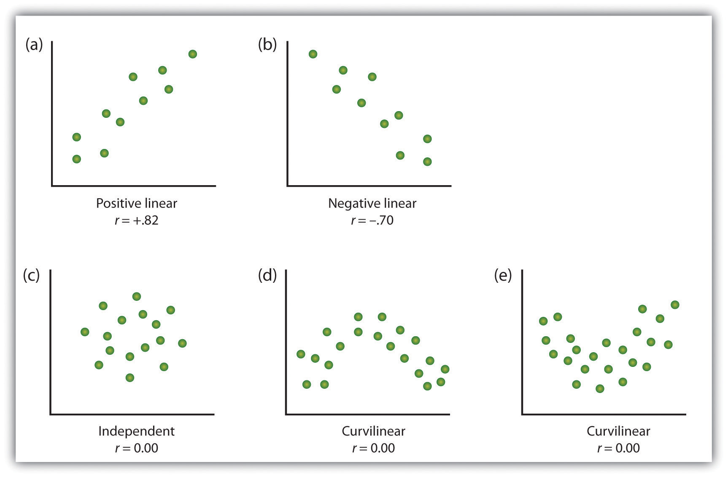
The point: patterns of data
Examining patterns in data (critically)
Finding the right way to describe and test these patterns
https://opentextbc.ca/introductiontopsychology/chapter/2-2-psychologists-use-descriptive-correlational-and-experimental-research-designs-to-understand-behavior/
Notes:
This is not a course about statistics. The statistics comes at the end. Rather we are interested in data, in patterns of data, and what it can tell us.
Here is an example. On the x axis is the ratings of emotionality of tv adverts, and on the y axis is the sales success of the product. What relationship does each graph show?
Always look at the data.

Slide 13
Module outline week1-5
Week 1: Introducing data, introducing Rstudio
Week 2: Manipulating data, using Rstudio
Week 3: Exploring data and creating figures and graphs, using Rstudio
Week 4: Categorical data and the chi-squared test – testing random versus structured?
Week 5: t-tests – testing whether two groups are different

Slide 14
Module outline week6-10
Week 6: Introduction to your research report
Week 7: Measurement, hypotheses, associations (correlations)
Week 8: Predicting behaviour: the linear model
Week 9: Data visualisation
Week 10: Predicting behaviour: developing the linear model

Slide 15
Summary
What’s the point of statistics?
  Understand and be critical of claims relating to data
  Link data to theories

